Slide 1

TELECOM CUSTOMER CHURN PREDICTION USING MACHINE LEARNING

Slide 2


TEAM MEMBERS
Vijay Kumar Sripada- 18UK1A0554
Shravya Madatha- 18UK1A0551
Pooja Poreddy - 18UK1A0546
Sai Shashank Lingabathini - 18UK1A05228

Slide 3

TABLE OF CONTENTS
Objective
Introduction
Procedure
Solution
Output
Summary

Slide 4

OBJECTIVE
To predict the customer churn.
Highlighting the main variables/factors influencing Customer Churn.
To build prediction models, evaluate the accuracy and performance of the model using machine learning algorithm(Logistic Regression).

Slide 5

INTRODUCTION
Customer churn has become highly important for companies because of increasing competition among companies, increased importance of marketing strategies and conscious behaviour of customers in recent years. Customers can easily trend toward alternative services. Companies must develop various strategies to prevent these possible trends, depending on the services they provide. During the estimation of possible churns, data from the previous churns might be used. An efficient churn predictive model benefits companies in many ways. Early identification of customers likely to leave may help to build cost effective ways in marketing strategies. Telecommunication industry always suffers from a very high churn rates when one industry offers a better plan than the previous there is a high possibility of the customer churning from the present due to a better plan in such a scenario it is very difficult to avoid losses but through prediction we can keep it to a minimal level. A machine learning model is built and this helps to identify the probable churn customers and then makes the necessary business decisions.

Slide 6

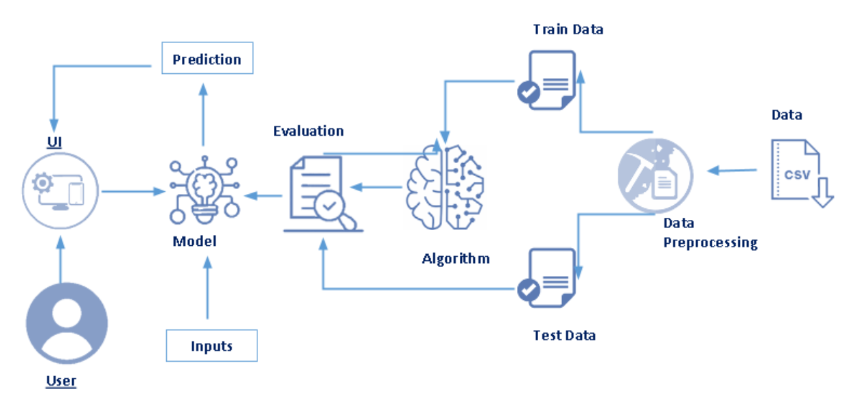
PROCEDURE

Slide 7

SOLUTION
When working with our data that accumulates to a binary separation, we want to classify our observations as the customer “will churn” or “won’t churn” from the platform. A logistic regression model will try to guess the probability of belonging to one group or another. The logistic regression is essentially an extension of a linear regression, only the predicted outcome value is between [0, 1]. The model will identify relationships between our target feature, Churn, and our remaining features to apply probabilistic calculations for determining which class the customer should belong to.

Slide 8

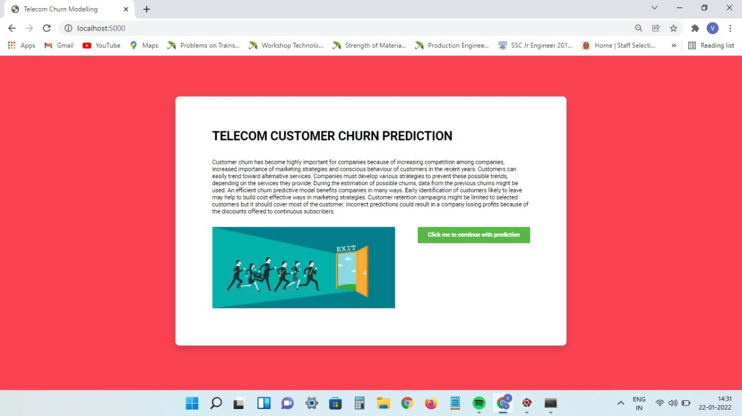
OUTPUT

Slide 9
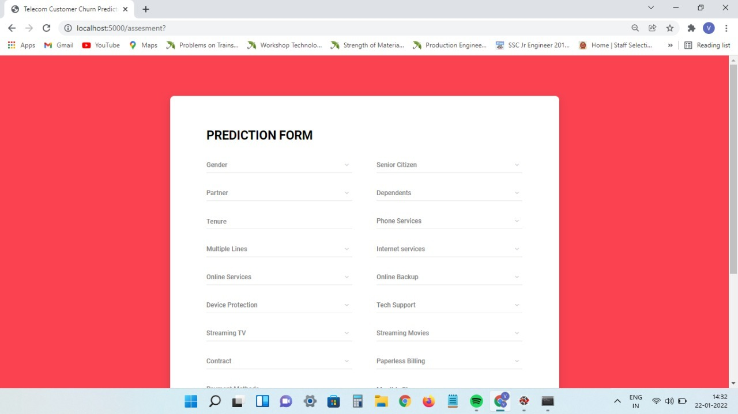

Slide 10
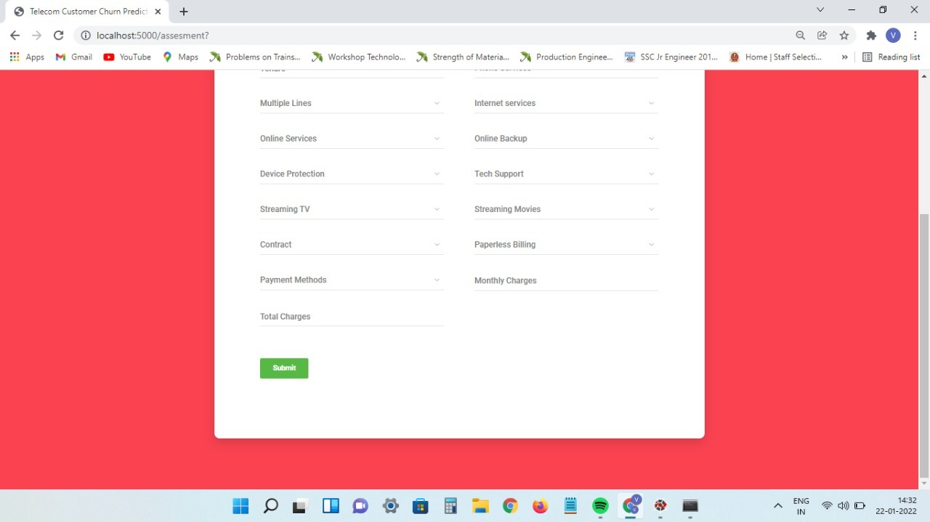

Slide 11
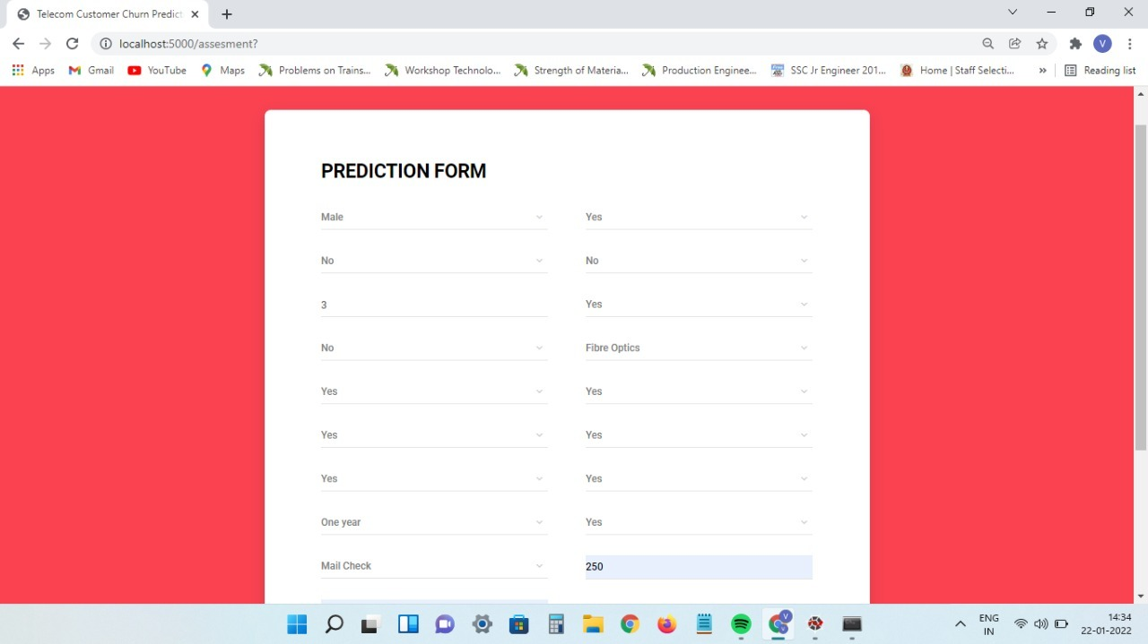

Slide 12
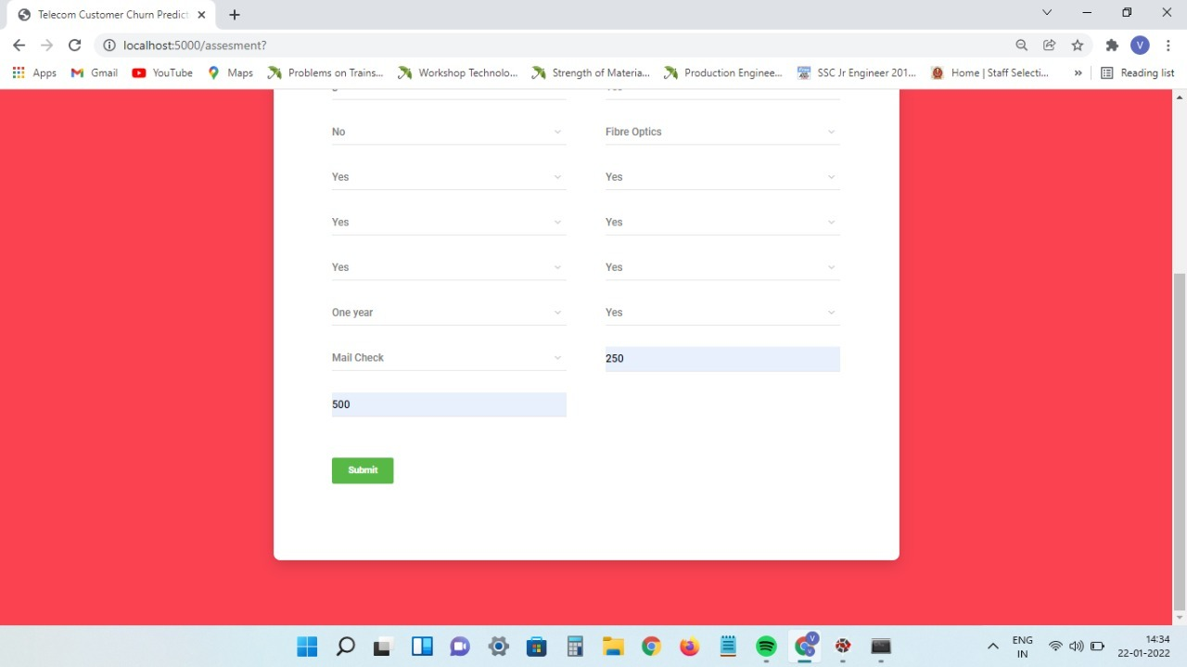

Slide 13
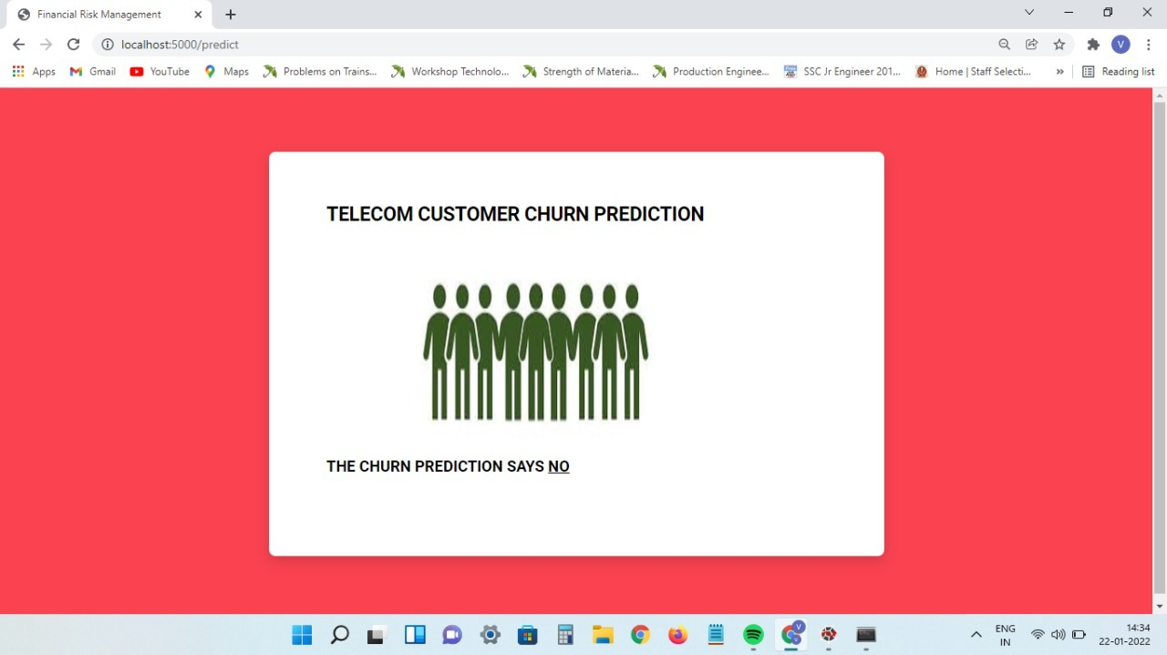

Slide 14

SUMMARY
The importance of this type of research in the telecom market is to help companies make more profit. It has become known that predicting churn is one of the most important sources of income to Telecom companies. Hence, this research aimed to build a system that predicts the churn of customers in telecom company with using Logistic Regression Classifier of Machine Learning with 80% accuracy.

Slide 15

THANK YOU

